Slide 1
OBJECT ORIENTED PROGRAMMING (IT-203) CWS PROJECT
CREATED BY : -
VARUN KUMAR (2K19/IT/140)
YASHIT KUMAR (2K19/IT/149)

Slide 2
STUDENT AND TEACHER MANAGEMENT SYSTEM

Slide 3
INTRODUCTION
Student and Teacher Management System is a Project for education establishments to manage student and teacher data
Its capabilities include the basics such as report cards, personal records of students and teacher as well as many other specialized capabilities like student grades , percentage , stream and subject toppers on console application.
This means that not only administrators but also , teachers, and students have access to real-time data.

Slide 4
The Student and Teacher Management System will replace the paper-based data collection and information exchange system among the various departments of a particular school.
The STMS provides an innovative solution for Today’s school record-keeping challenges.
So we decided to make C++ console based application on Student and Teacher Management System .

Slide 5
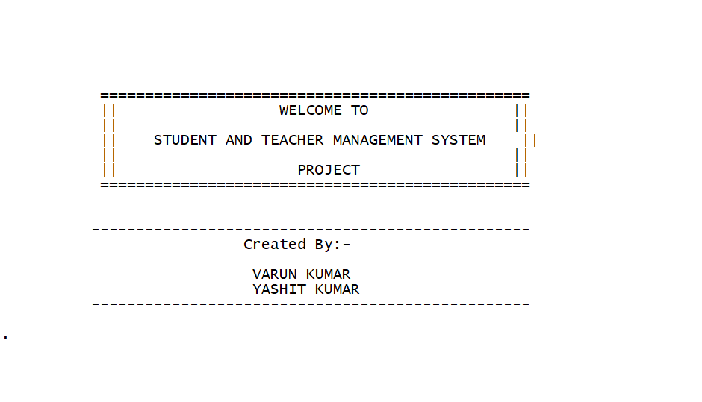

Slide 6
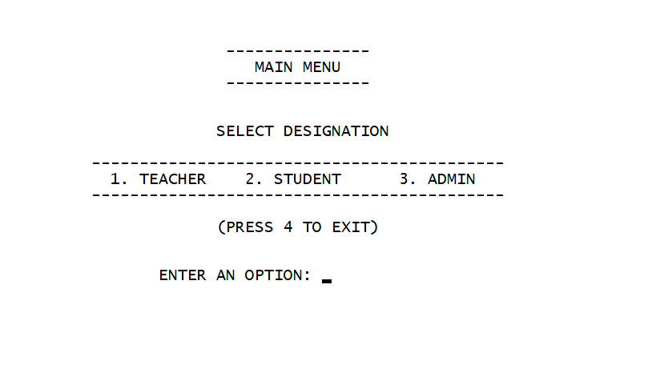
FEATURES OF OUR PROJECT
We have divided system into three portals : -
1. Teacher 2 . Student 3. Adminstration

Slide 7
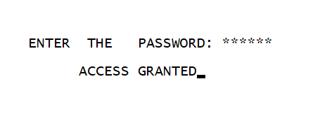
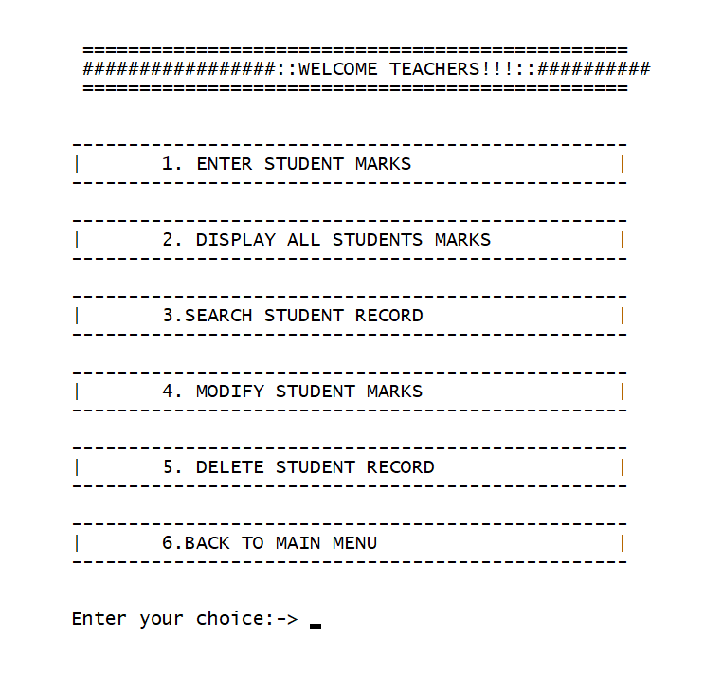
Teacher Portal
1 . Enter Student Marks
2. Display All student Marks
3. Can search Student Record
4. Can modify Student Marks
5. Can delete Student Record

Slide 8
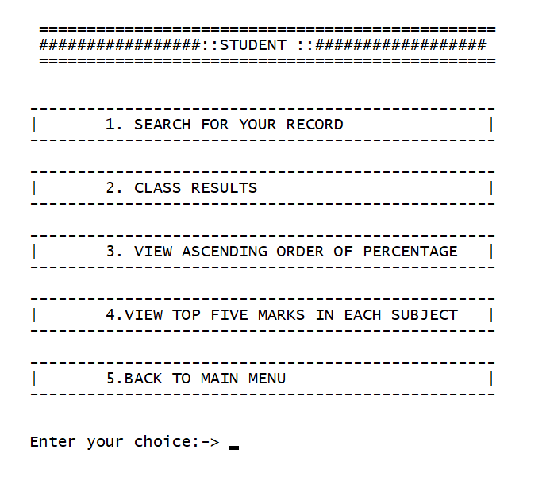
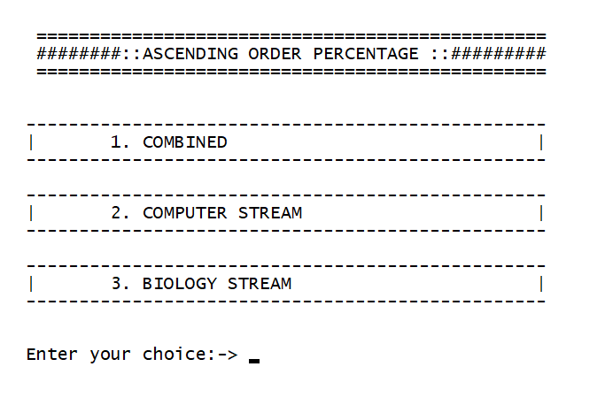
Student Portal
1. Search for its record
2. Check Class Result Streamwise
3. View All Students Percentage(sorted)
4. View Top 5 Scorers in each subject

Slide 9
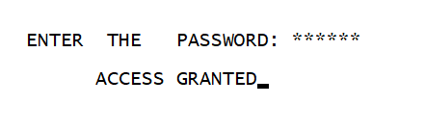
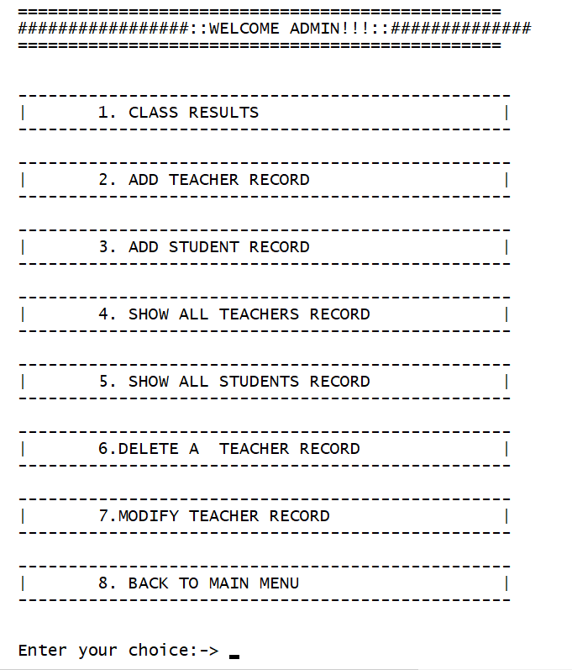
Adminstration Portal
1. Class Result Streamwise
2. Add Teacher Record
3. Add Student Record
4. Show All Teachers Record
5. Show All Students Record
6. Delete Teacher Record
7. Modify Teacher Record

Slide 10
OOP CONCEPT USED
Abstraction - It is one of the most essential and important feature of object oriented programming in C++. Abstraction means displaying only essential information and hiding the details.
Classes Created :-
1. Person
2. Student
3. Teacher
4. Admin
Encapuslation - Encapsulation is defined as binding together the data and the functions that manipulates them.
All the four classes have this feature

Slide 11
Friend Function / Classes Used – A friend class can access private and protected members of other class in which it is declared as friend.
So we make class Teacher friend of class Student so that teacher can access student data
A friend function can be given special grant to access private and protected members .
Functionality Class Result and Display student marks can be used by both Student class and Teacher so we make both the functions friend .
Inheritance - Inheritance is one of the feature of Object Oriented Programming System . It allows the child class to acquire the properties (the data members) and functionality (the member functions) of parent class.
We have used hyrid inheritance
(D1) (Base) (D2) (D3)
Student < ------- Person ------ > Teacher ------- > Admin

Slide 12
Exception Handling - A C++ exception is a response to an exceptional circumstance that arises while a program is running, such as an attempt to divide by zero
It is Used when admin or teacher try to enter the information about student and enter invalid info and also it is used when the user is trying to enter wrong password at admin portal.
And also when the teacher enter marks out of range i.e above 100
When Date of Birth or phone number entered is invalid .
File Handling - File Handling is used to store the record of the Teacher and Student .

Slide 13
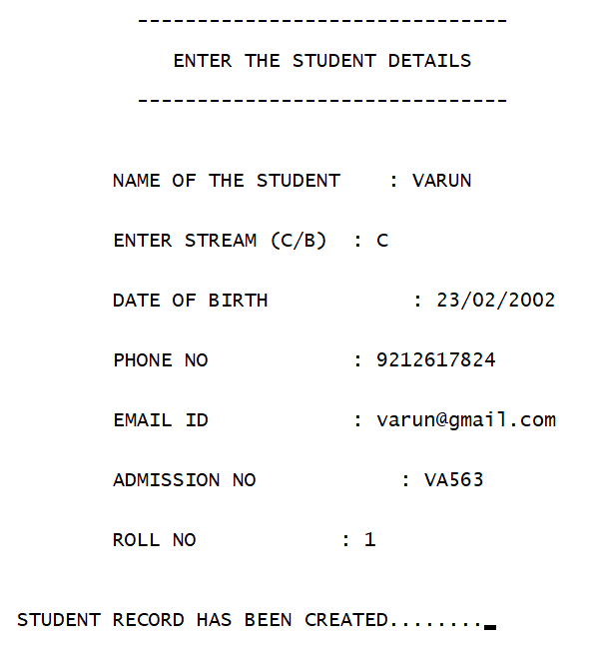
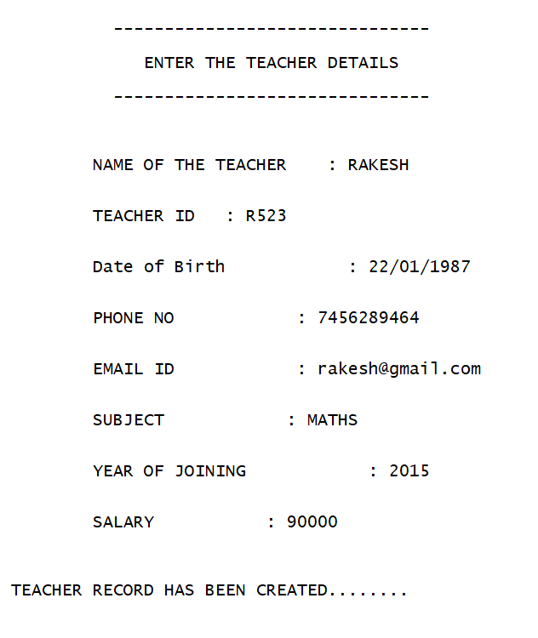
Working DEMO
Adminstration Entering Student and Teacher Details

Slide 14
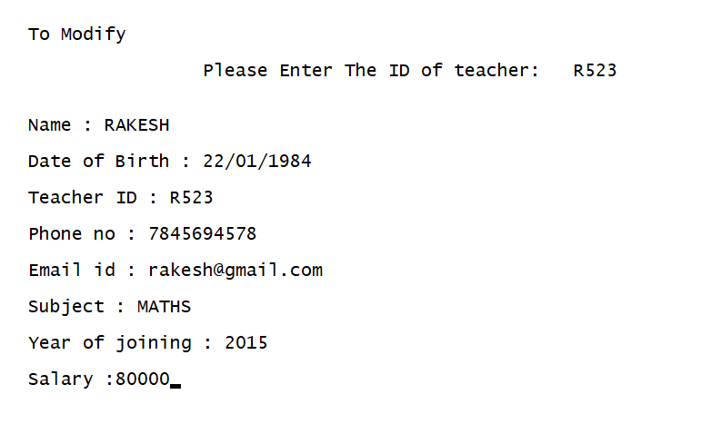
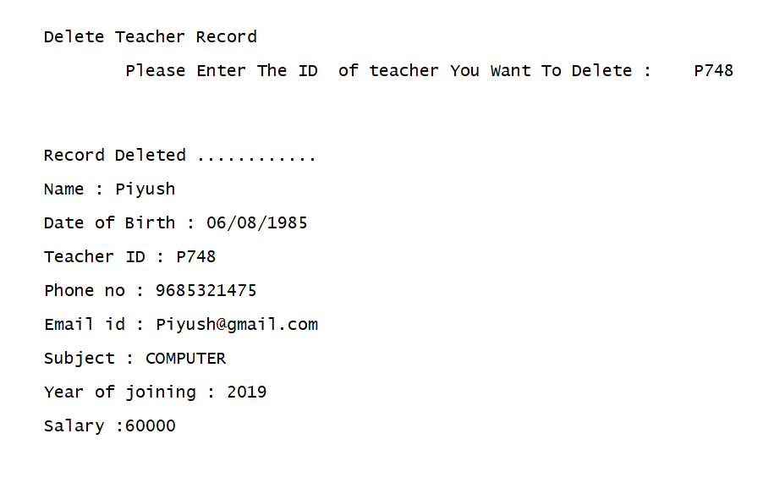
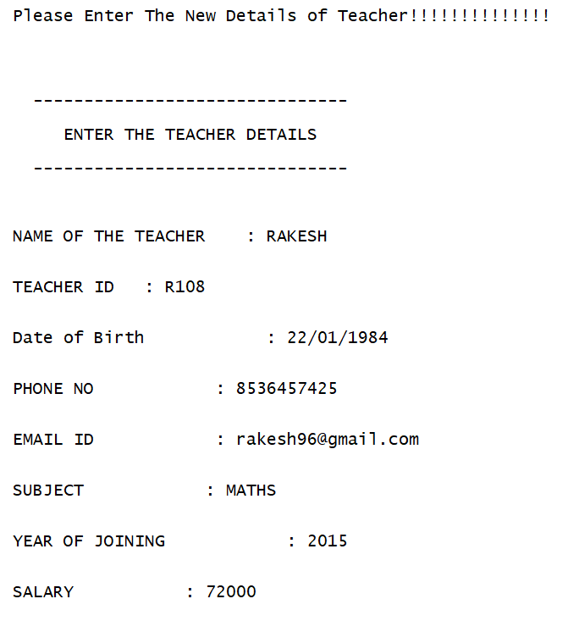
Adminstration Modifying and Deleting Records

Slide 15
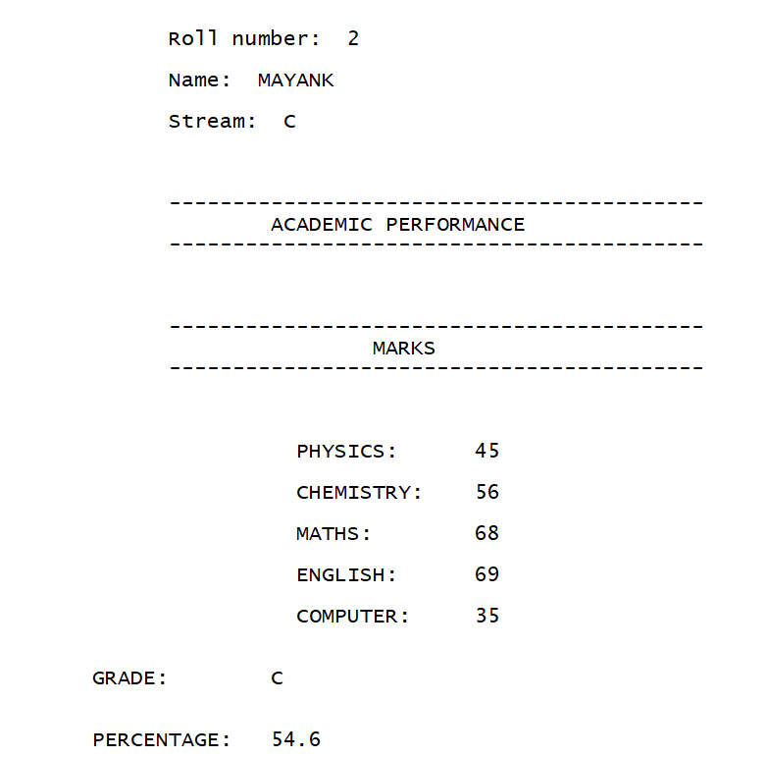
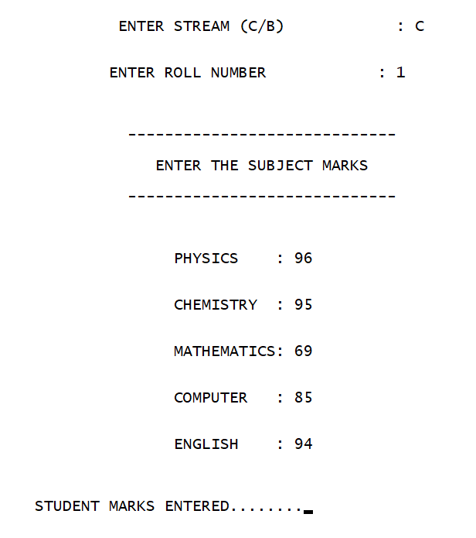
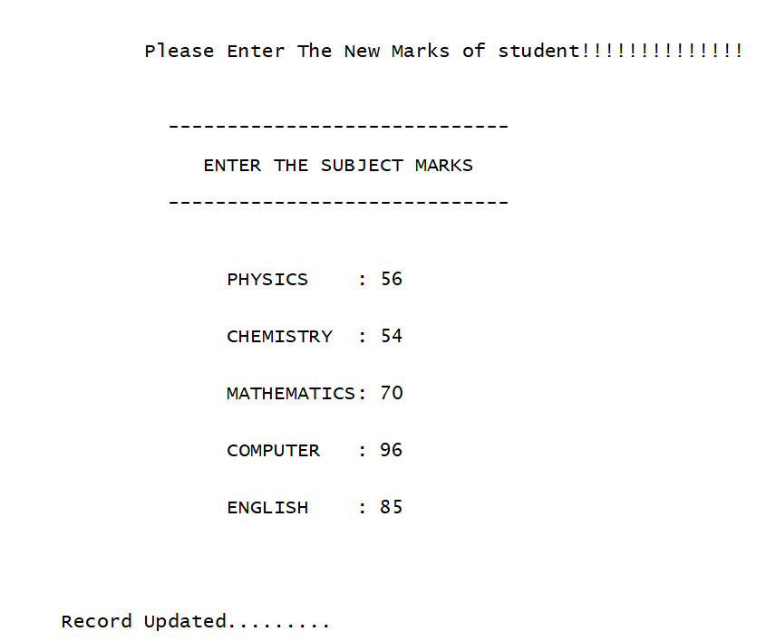
Teacher Entering Student Marks And
also Modifying Marks

Slide 16
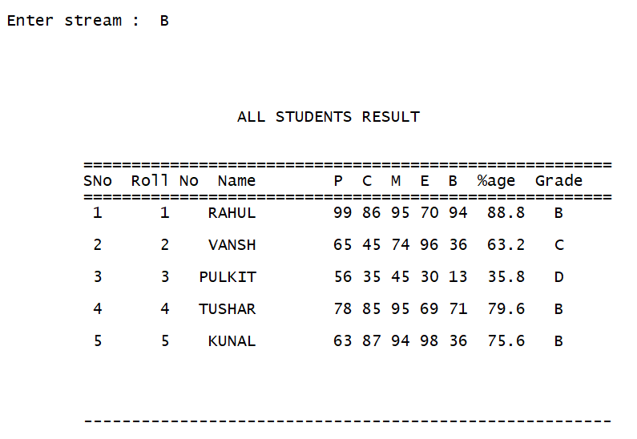
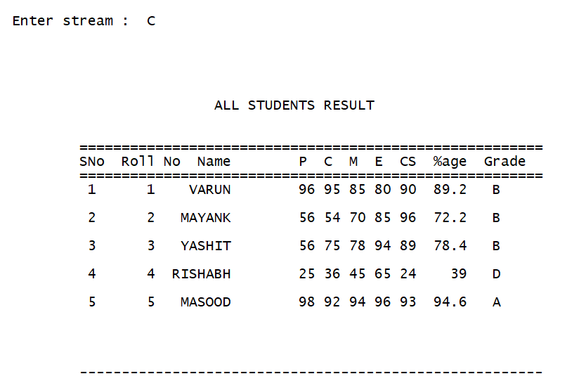
Student or Teacher or Admin can view Streamwise Class Result

Slide 17
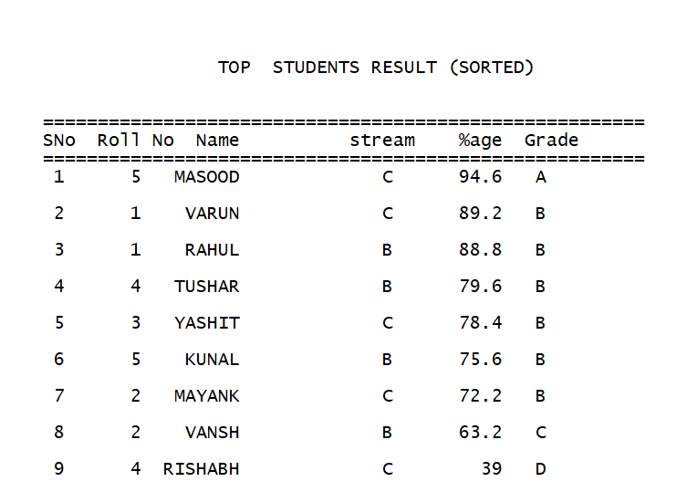
Combined Class Result percentage Wise Sorted

Slide 18
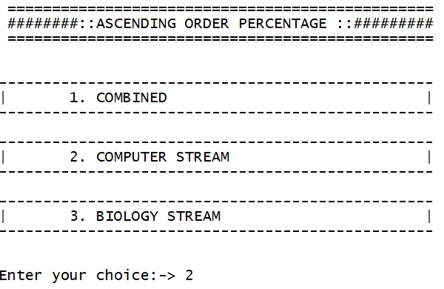
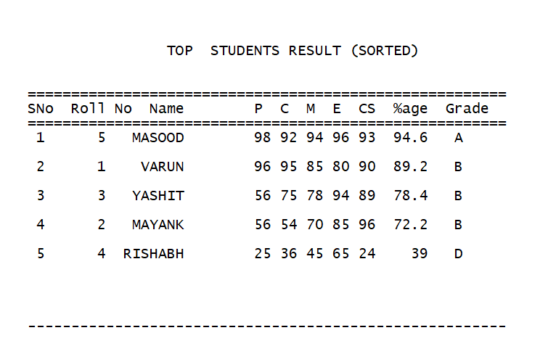
Streamwise Result Percentage Sorted

Slide 19
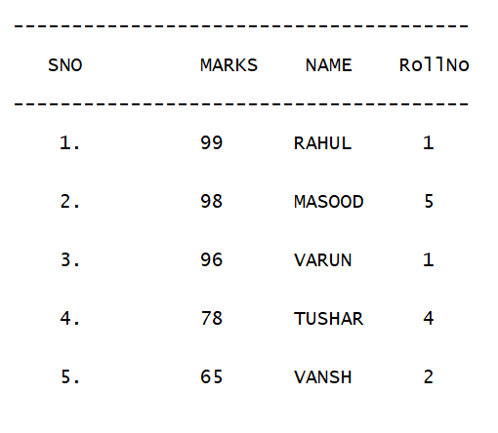
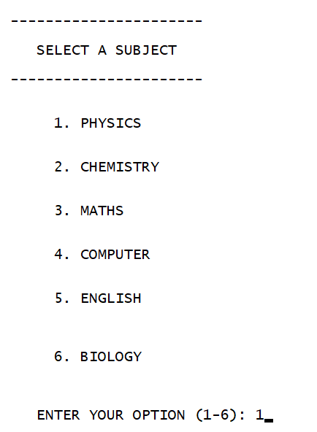
Top 5 Scorers in each Subject

Slide 20
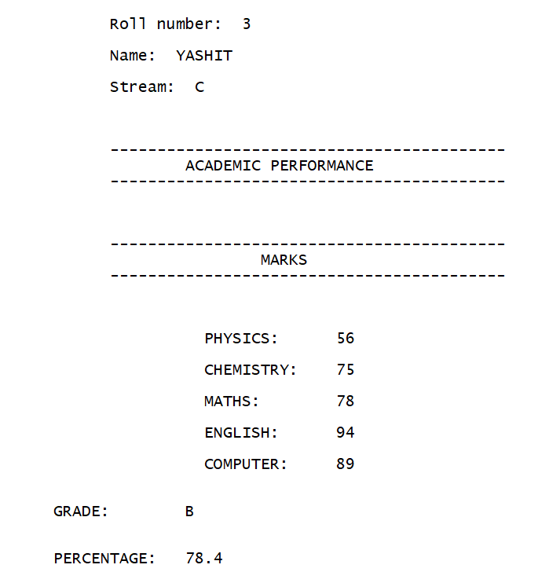
Student can view his Record

Slide 21
SOURCE CODE GITHUB LINK
https://github.com/varunkmr038/OOP-Project/blob/main/Student%20and%20Teacher%20Management%20System.cpp

Slide 22
BIBLIOGRAPHY
https://www.geeksforgeeks.org/object-oriented-programming-in-cpp/
Geetanjali Mam Notes
https://www.geeksforgeeks.org/friend-class-function-cpp/
https://www.geeksforgeeks.org/file-handling-c-classes/

